Slide 1

Predicting Loss-Making Firms Using Administrative Tax Data

Slide 2

Purpose and Policy Context
Value Proposition:
Enables risk-based targeting in place of blanket audits by developing an automated risk scoring system that:
Processes firm-level Corporate Income Tax (CIT) return data following the methodology outlined in the project proposal.
Employs an iterative modeling approach, starting with interpretable logistic regression as a primary benchmark.
Leverages machine learning techniques to identify high-risk, loss-reporting firms for targeted compliance interventions.
Main Objective: To predict the probability of a firm reporting a loss.
Business and policy Problem:
Specific Objectives
Empirically identify firm-level characteristics associated with loss reporting in CIT returns.
Develop a supervised predictive model to estimate the probability of a firm reporting a loss.
Assess the concentration and distribution of loss behavior across sectors and firm groups.
Translate firm-level loss probabilities into insights on aggregate CIT revenue risk.
Kenya has persistently failed to meet Corporate Income Tax (CIT) revenue targets. The high prevalence of firms reporting losses significantly erodes the effective tax base, creating fiscal uncertainty
Persistent loss-making firms create compliance risk, inefficient audit allocation and revenue uncertainty.

Slide 3
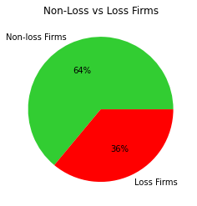
Data understanding and Overview
Data Source:
Class Balance: moderately imbalanced a with approximately 36 loss firms and 64 non-loss firms
The analysis is based on raw 2024 Corporate Income Tax (CIT) return data obtained from administrative tax filings. The dataset contains:
313,870 firm-year observations
61 variables
47 numeric variables (primarily financial statement items)
14 categorical variables, mainly capturing:
Sector classification
Firm size categories
Target Variable Definition
The target variable is defined as:
is_loss = 1 if Profit Before Tax (PBT) < 0
is_loss = 0 otherwise
Analytical scope
Retain only firms with positive turnover, which serves as a proxy for active businesses. This excludes dormant or non-operational entities so as to reduce noise and bias the model toward structural losses rather than behavioral or economic risk.

Slide 4
Data Cleaning and Feature Engineering
Data Cleaning
Feature Engineering
Initial Data quality Checks:
This stage translates raw accounting line items into economically meaningful indicators
Quality data checks performed ; with more focus on :
Missing values,
Duplicates
Coercion of mostly-numeric object columns to numeric types.
Numeric sanity checks(Turnover, costs , profit etc.)
Design Principles
Feature construction follows four guiding principles:
Economic interpretability: Features reflect clear business concepts (costs, leverage)
Scale normalization: Ratios relative to turnover for comparability across firm sizes.
Leakage avoidance: No features derived from profit/target.
Noise robustness: Safe divisions and explicit missing-value handling.
Standardization key categorical fields
Sector names standardized
Rare sectors grouped for stability
Core accounting fields aligned: Turnover Profit before tax,, Allowable deductions
High-missing variables tagged (≥60%) and excluded from modelling
Ratio-Based Core Features
Construction of a set of the following ratios:
Cost-to-Turnover: Revenue absorbed by direct costs
Admin Cost Ratio: Overhead intensity
Employment Cost Ratio: Labour cost pressure
Financing Cost Ratio: Leverage / debt stress
Deductions-to-Turnover: Reliance on allowable deductions
Restricting the Modelling Sample
For comparability and validity, restriction of the modelling sample was done to firms that meet all of the following conditions:
Non-missing gross turnover
Positive gross turnover (active firms)
Non-missing profit before tax
This reduces records/ data for modelling to 99,332 with 70 columns
Class imbalance is maintained for sample.

Slide 5
Data Cleaning and Feature Engineering
Feature Engineering…cont.
Binary Indicators for Threshold Effects
As loss risk is often non-linear, firms near cost saturation behave differently from those with healthy margins. The following binary indicators were used:
High-Cost Flag: Cost-to-turnover > 90% → extreme cost pressure
Thin-Margin Flag: Margin 95–105% → near break-even, vulnerable to shocks
Turnover Stratification
Firms are also grouped into turnover quartiles:Q1 (smallest firms) → Q4 (largest firms) so as to capture scale effects and identify whether loss incidence is concentrated among smaller or larger firms and to support policy-relevant segmentation
Outlier Handling
Uncontrolled outliers can dominate model estimation, leading to unstable and misleading results.
Each ratio feature is winsorised at the 1st and 99th Percentiles where the extreme low and high values are capped.

Slide 6
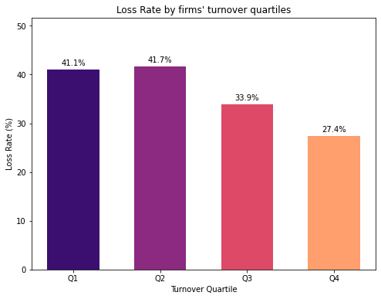
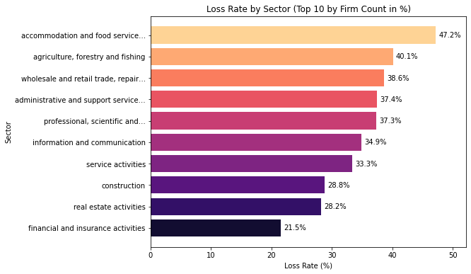
Exploratory Data Analysis – Key Patterns
EDA shows strong and intuitive separation between loss and non‑loss firms:
Firm size:
Loss rates exceed 40% in the bottom turnover quartiles
Decline steadily with size, but remain material even among large firms
Loss rate by sector
The chart shows the loss rates within the largest sectors. This restricts attention to sectors with many firms, it reveals which economically important sectors also exhibit elevated loss incidence.
All sectors are prone to loss rate incidences, however, the losses are concentrated in certain sectors

Slide 7
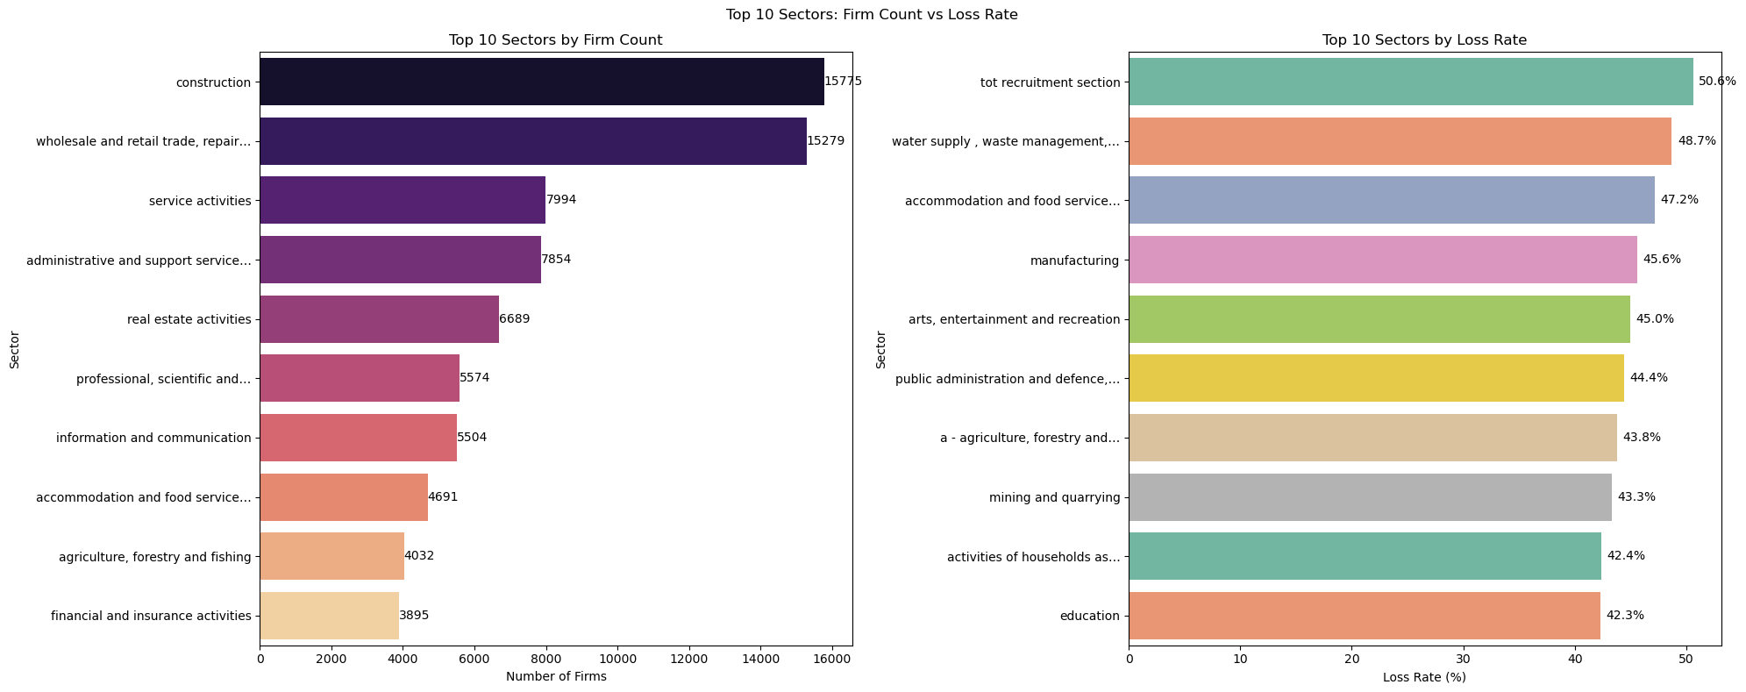
Exploratory Data Analysis – Key Patterns
EDA shows strong and intuitive separation between loss and non‑loss firms:
Loss rate by sector
- The panel A chart shows the size of a sector, highlighting where economic activity is most concentrated, such as construction and wholesale & retail trade, but it does not indicate whether firms in these sectors are profitable or loss-making. This chart shows the size of a sector.
- The Panel B chart is interpreted as a measure of risk intensity and shows risker sectors interms of tunrover as depicted by loss rate. This ranks sectors by the %age of firms reporting losses, regardless of how many firms the sector contains. As a result, some sectors with relatively few firms appear at the top because they have a high incidence of losses.

Slide 8
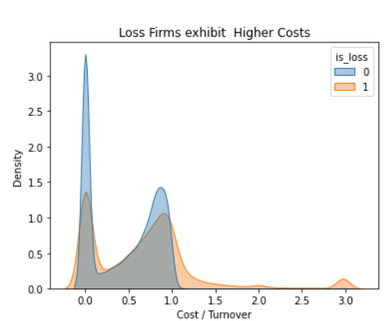
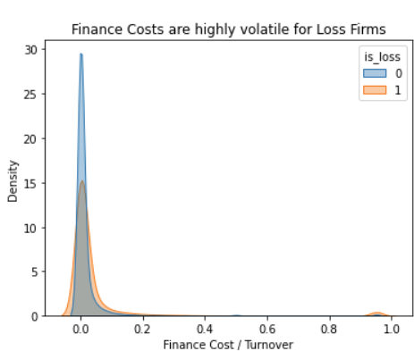
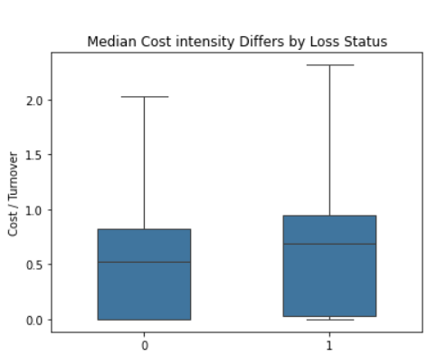
Exploratory Data Analysis – Key Patterns
EDA shows strong and intuitive separation between loss and non‑loss firms:
Cost intensity:
Loss firms show higher medians and heavy right tails indicating structural cost pressure.
Firms that make losses consistently spend more relative to their turnover than profitable firms.
This pattern is seen across the full range of firms, not just extreme cases, indicating that high operating costs are a core driver of financial distress.
Financing costs:
Right‑skewed among loss firms, suggesting leverage and financing structure effects.
Finance cost are highly volatile for Loss Firms: while most firms have lower finance costs such as borrowing and interest rate costs, high ratios appear more often in loss firms adding volatility
Median cost intensity :
The chart shows that even the typical loss-making firm has higher costs relative to sales than a typical profitable firm.
The difference is not driven by rare outliers, confirming that high costs are a consistent issue for firms making losses.

Slide 9
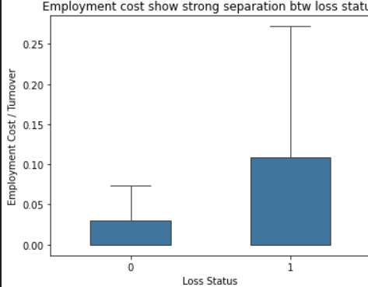
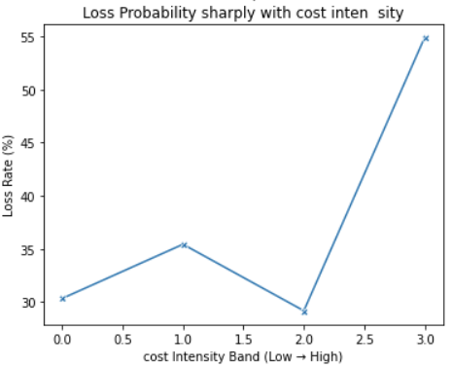
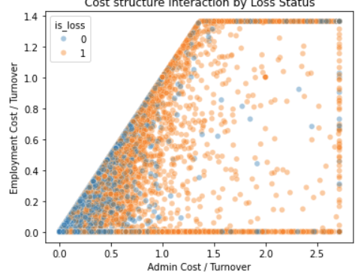
Exploratory Data Analysis – Key Patterns
EDA shows strong and intuitive separation between loss and non‑loss firms:
Employment Cost
Employment costs show strong separation: Loss-making firms tend to spend a higher proportion of their sales on staff costs than profitable firms.
Since wages are difficult to reduce quickly, high employment costs make these firms more susceptible to losses and financial strain.
Loss Probability:
The probability rises sharply with cost intensity The chance of making a loss increases gradually with cost levels at first but rises sharply once costs reach high levels.
This highlights a threshold effect where costs become unsustainable, and losses become much more likely.
Cost structure interaction by Loss Status:
Firms with both high admin and high staff costs are much more likely to make losses.
Profitable firms usually keep at least one of these costs under control, showing that combined cost pressures are particularly dangerous.

Slide 10
Data Preparation and Preprocessing Summary
Modelling Strategy
Sample and Feature summary
Got a baseline and progressed to richer models:
Logistic Regression- Baseline
Random Forest
Gradient Boosting
XGBoost
Identical preprocessing across all models:
Median imputation (numeric) and Modal imputation + one-hot encoding (categorical)
Final dataset (post-cleaning and feature engineering):
99,332 firm observations
Split into:
Training set: 74,499 observations
Test set: 24,833 observations
Explanatory features: 289: Which includes engineered ratios, structural flags, and one-hot encoded categorical controls.
Test set loss rate = 36%. This indicates moderate class imbalance, motivating metrics beyond simple accuracy such as ROC–AUC, Precision–Recall)
Basic Model Results – Interpreting Loss Drivers
Primary drivers of losses:
Cost structure
Financing intensity
Sector and size are conditioning factors, not root causes
Policy focus:
Support cost efficiency improvements
Ease financing constraints
Target small and manufacturing firms for compliance monitoring,
risk assessment, or targeted support

Slide 11
Models results and comparison
Model | ROC–AUC | PR–AUC | Key Takeaway
Logistic Regression (Baseline) | 0.74 | 0.66 | Interpretable benchmark; shows losses are driven by cost structure, size, and sector, but limited in capturing nonlinear effects.
Random Forest | 0.76 | 0.71 | Strong improvement over linear models; better recall of loss firms but lower precision and weaker calibration.
HistGradientBoosting | 0.799 | 0.755 | Confirms boosting is well suited; efficient and accurate, but limited control and interpretability.
XGBoost (Fast-tuned) | 0.799 | 0.7515 | Best overall discrimination; flexible regularisation and strong precision for high-risk firms.
Optimised XGBoost (Early-Stopping) | 0.80 | 0.7512 | Best calibrated and most stable model; preferred for operational, risk-based compliance profiling.
Key Insights:
XGBoost: provides highest discrimination and precision, ideal for targeted risk profiling
Random Forest : higher recall, lower precision → better for broad coverage but less targeting efficiency
Logistic Regression: linear specification underperforms, limited for complex nonlinear patterns

Slide 12
Feature Importance
Feature Importance (GAIN):
Measures average improvement in the objective function due to splits on each feature
Top drivers:
Cost-to-turnover ratio – strongest predictor, highlights centrality of cost pressure
Sectoral indicators – Construction, Financial/Insurance, Manufacturing: reflecting structural differences in profitability across industries.
Firm size quartiles – especially largest firms (Q4), indicating systematic differences in loss incidence across the size distribution
High-cost / thin-margin flags – capturing firms operating close to viability thresholds
Financing and deduction intensity – pointing to the role of leverage and tax-related adjustments in shaping reported losses
XGBoost captures nonlinear interactions between costs, size, and sector more effectively than linear/logistic models, while maintaining economic interpretability.

Slide 13
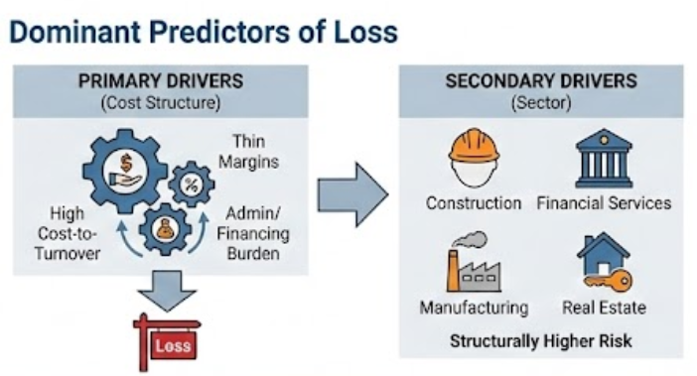
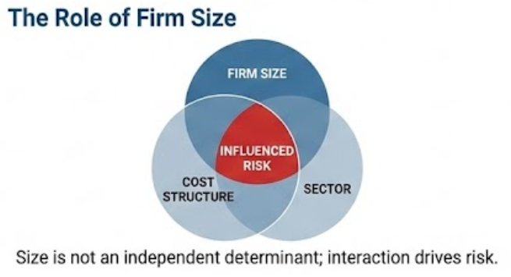
STRATEGIC RECOMMENDATIONS
1. Operational Implementation
Adopt XGBoost: Deploy the optimized model as the standard for loss-risk scoring to leverage its superior non-linear discrimination.
Risk Banding: Shift form binary “Loss/Non-loss” flags to predicted probability bands for smarter audit prioritization and resource allocation.
Forward-Looking Monitoring: Embed the model into revenue monitoring to identify emerging loss clusters early.
2. Policy & Compliance Re-Orientation
Refine Risk Profiling: Move away from “firm size” as a primary risk proxy. Focus instead on cost structure indicators (e.g., efficiency ratios) regardless of turnover.
Sector-Specific Thresholds: Establish distinct risk benchmarks for high-risk sectors (Construction, Real estate, Manufacturing) where loss propensity is naturally higher.
Target Enforcement: Complement broad policies (like minimum tax) with model-driven audits targeting firms with persistent, economically implausible loss patterns.

